Slide 1

Machine Learning

Slide 2
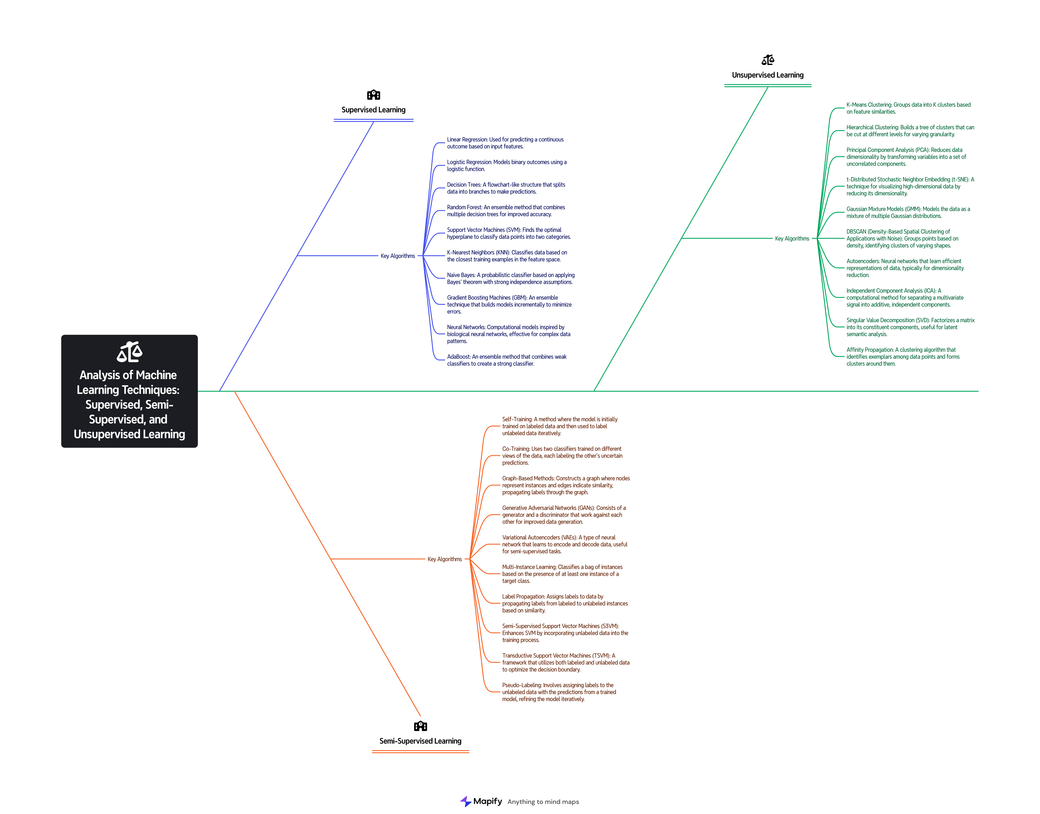

Slide 3
Supervised Learning
Linear Regression
Logistic Regression
Decision Trees
Random Forest
Support Vector Machines (SVM)
K-Nearest Neighbors (KNN)
Naive Bayes Classifier
Gradient Boosting Machines (GBM)
Neural Networks
AdaBoost

Slide 4
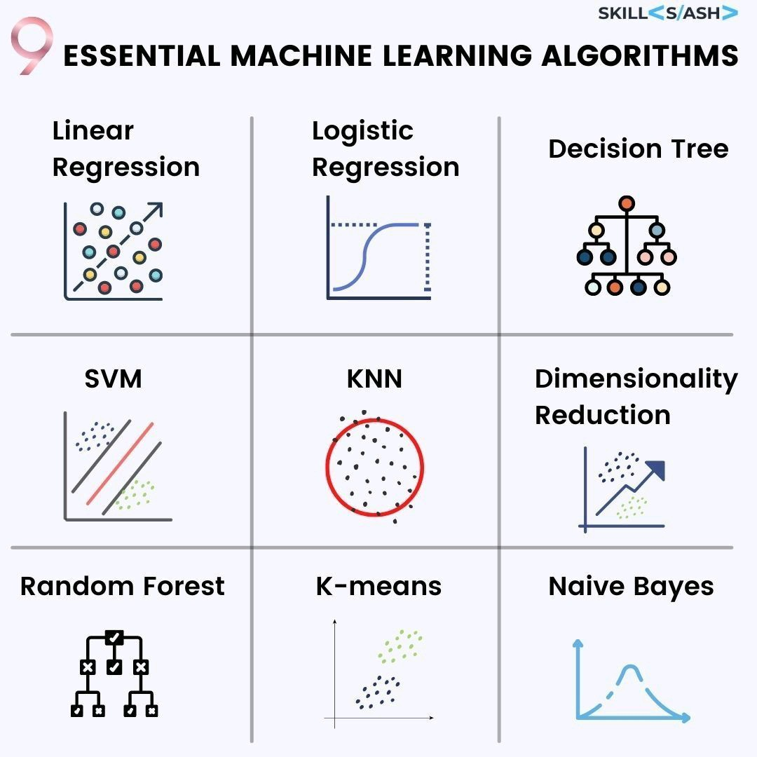

Slide 5
Semi-Supervised Learning
Self-Training
Co-Training
Graph-Based Methods
Generative Adversarial Networks (GANs)
Label Propagation
Consistency Regularization
Multi-Instance Learning
Semi-Supervised Support Vector Machines
Uncertainty Sampling
Transductive Learning

Slide 6
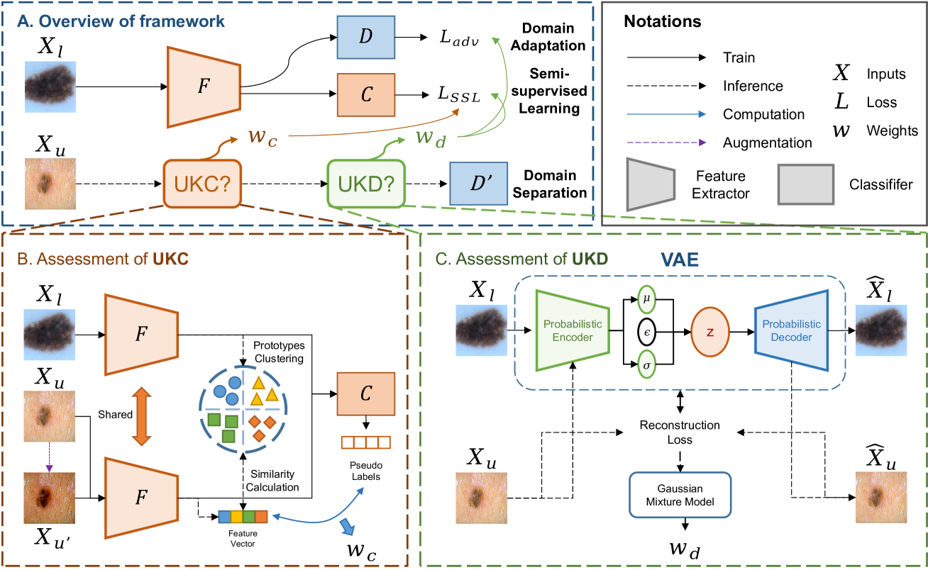

Slide 7
UnSupervised Learning
K-Means Clustering
Hierarchical Clustering
DBSCAN (Density-Based Spatial Clustering)
Gaussian Mixture Models
Principal Component Analysis (PCA)
t-Distributed Stochastic Neighbor Embedding (t-SNE)
Independent Component Analysis (ICA)
Autoencoders
Association Rule Learning
Hidden Markov Models (HMM)

Slide 8
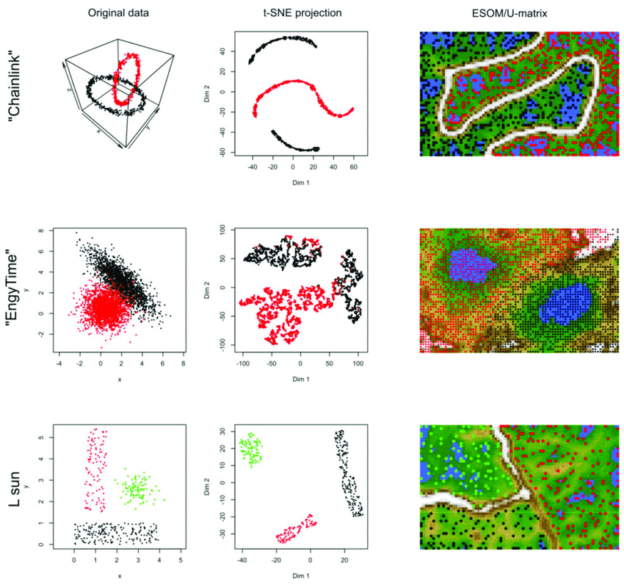

Slide 9
Supervised Learning
Supervised learning involves training a model on labeled data. This means that each training example is paired with an output label. The goal is for the model to learn the relationship between the input data and the output labels so it can predict the labels for new, unseen data.
Example: Predicting whether an email is spam or not (spam detection).

Slide 10
Semi-Supervised Learning
Semi-supervised learning is a middle ground between supervised and unsupervised learning. It uses a small amount of labeled data and a large amount of unlabeled data. This approach is useful when labeling data is expensive or time-consuming. The model learns from the labeled data and uses the patterns in the unlabeled data to improve its performance.
Example: Classifying images when only a few images are labeled, but a large number of images are available.

Slide 11
Unsupervised Learning
Unsupervised learning deals with data that has no labels. The goal is to find patterns or relationships in the data. The model tries to group or cluster the data based on similarities without any guidance from output labels.
Example: Customer segmentation based on purchasing behavior.

Slide 12
Supervised Learning == > Trains on labeled data to predict output labels for new data. == > Email spam detection
Semi-Supervised Learning == > Uses a mix of a small amount of labeled data and a large amount of unlabeled data. == > Image classification with limited labels
Unsupervised Learning == > Finds patterns or relationships in data without using labels. == > Customer segmentation

Slide 13
Supervised Learning Algorithms
Linear Regression:
Used for predicting continuous values.
Logistic Regression:
Used for binary or multi-class classification problems.
Support Vector Machines (SVM):
Used for classification tasks by finding the best boundary that separates classes.

Slide 14
Decision Trees:
Used for both classification and regression tasks by splitting the data into branches to make decisions.
Random Forest:
An ensemble method that combines multiple decision trees to improve prediction accuracy.
K-Nearest Neighbors (KNN):
Used for classification and regression by averaging the k-nearest neighbors' values.

Slide 15
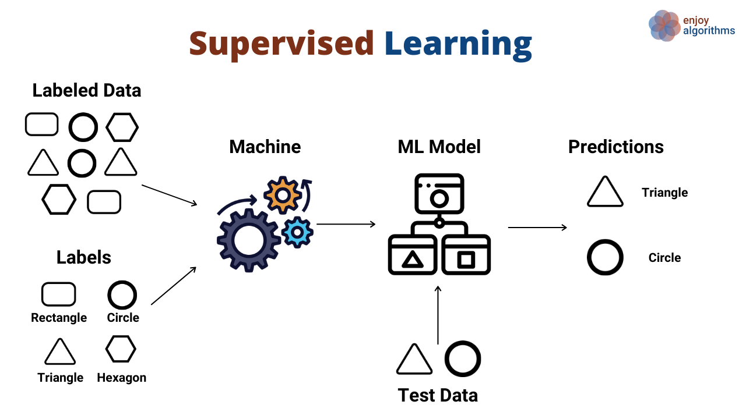
Supervised Learning Process

Slide 16
Semi-Supervised Learning Algorithms
Self-Training:
Uses its own predictions on unlabeled data as pseudo-labels for training.
Co-Training:
Uses multiple classifiers and iteratively labels the unlabeled data.

Slide 17
Graph-Based Algorithms:
Uses graphs to represent the relationships between labeled and unlabeled data.
Multi-View Learning:
Uses different views of the data to learn from labeled and unlabeled examples.

Slide 18
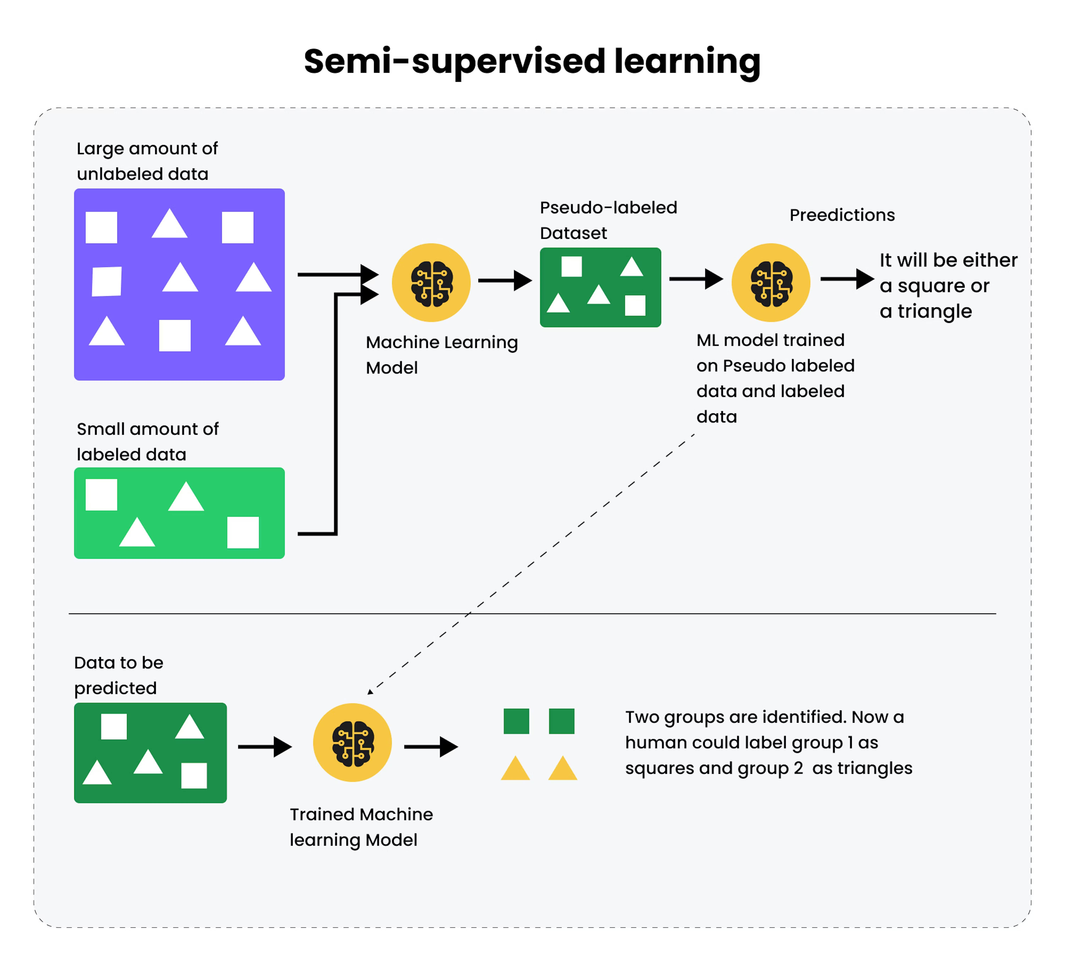
Semi-Supervised Learning Process

Slide 19
Unsupervised Learning Algorithms
K-Means Clustering:
Divides the dataset into clusters based on similarity.
Hierarchical Clustering:
Builds a hierarchy of clusters using either agglomerative or divisive methods.
DBSCAN (Density-Based Spatial Clustering of Applications with Noise):
Forms clusters based on density, useful for identifying outliers.

Slide 20
Principal Component Analysis (PCA):
Reduces the dimensionality of the data while preserving as much variance as possible.
t-Distributed Stochastic Neighbor Embedding (t-SNE):
Reduces the dimensionality of data for visualization purposes.
Isolation Forest:
Anomaly detection method that isolates anomalies instead of profiling normal data.

Slide 21
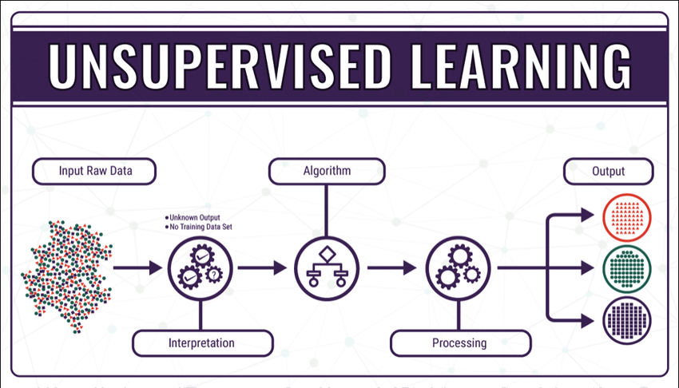
Unsupervised Learning Process

